Slide 1
CZ1015- FSP3 (Team 08)
Done by:
TAN MEI XUAN SEAH YONG ZHI GOH CHENG GUAN, CLIVE

Slide 2
AGENDA
Objective & Dataset Description
Data Preparation
Exploratory Data Analysis/Visualisation
Clustering Model
Clusters Analysis
Notes:
How should we structure the Presentation?
This is just a guideline -- feel free to choose your own style, depending on the work you did. You will have 10 minutes, total.
First 3 to 4 minutes of your presentation
You MUST mention which dataset you worked on, and what EXACTLY was your objective.
You may then want to BRIEFLY present your Exploratory Data Analysis and observations.
If it is an ML project (regression/classification/clustering/anomaly), mention which one(s).
You may now briefly clarify why and how the ML problem(s) aim(s) to solve your objective.
Next 3 to 4 minutes of your presentation
Is the data already clean/structured for your ML problem? If not, how did you prepare the data?
How did you apply ML technique(s) to solve your problem? Which model(s) did you use? Why?
Did you only use tools and techniques learned within the course? What else did you learn/try?
Last 2 to 3 minutes of your presentation
What is the outcome of your project? Did you meet your initial objective? Anything interesting?
You MUST conclude by clearly mentioning who in your team worked on which portion of work.

Slide 3
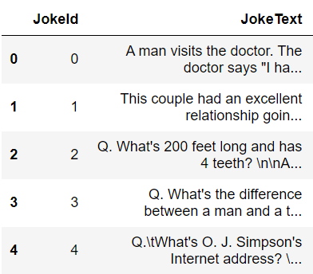
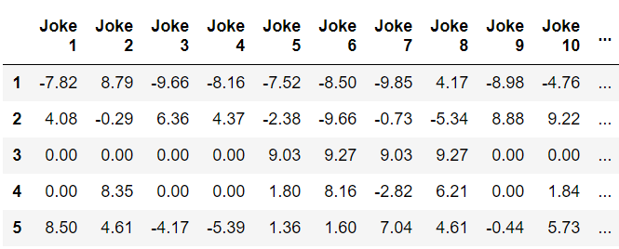
Dataset 3 : Jester Joke Dataset
2 CSV Files with 100 Jokes & 24984 Users
JokeText: 2 Columns, 100 Rows jester-data-1: 100 Columns, 24984 Rows

Slide 4
Dataset 3 : Jester Joke Dataset
Objective: Explore how users rate the jokes
To identify whether there’s diverse group with contrasting likes and dislikes of various jokes.
Machine Learning Technique: Clustering (Unsupervised Learning)
Clustering allows users to be separated into groups based on how similar they rated each jokes and let us analyse different clusters to look for contrasting views.
Notes:
The most common use of cluster analysis is classification. Subjects are separated into groups so that each subject is more similar to other subjects in its group than to subjects outside the group.
We run our cluster analysis with great expectations, hoping to uncover diverse segments with contrasting likes and dislikes of the jokes they rated
E.g. In Cluster 2: Strongly like Joke 23 however dislike Joke 1 strongly
Explore how users rate individual jokes
Explore how users rate different type of jokes. To identify whether there's diverse segment/group with contrasting likes and dislikes of various jokes.

Slide 5
Data Preparation
1

Slide 6
Data Preparation:
Dataset Given:
JokeText.csv: Contain 100 joke text
jester-data-1.xls: Jokes rating of 24,983 user

Slide 7
After Cleaning:
Cleaned Dataset-Joker.csv
- Used for Statistical Analysis & Clustering
JokeText_Category.csv
- Used for Network and Text Analysis

Slide 8
Credits and Acknowledgment:
JokeText.csv & jester-data-1.xls
▰ Compiled list of jokes in csv format
▻JokeText.csv by Aakaash Jois
▻https://www.kaggle.com/aakaashjois/jester-collaborative-filtering-dataset

Slide 9
JokeText_Category.csv
- For Network and Text Analysis

Slide 10
JokeText_Category.csv
- For Network and Text Analysis
Categories them into 6 different type of jokes
Dark: Jokes dealing with a pessimistic outlook like death
Ironic: Intended meaning is opposite of literal meaning
Juvenile: Jokes involving childish themes like name-calling
Political Humor: jokes with political references
Reference: Jokes that audience can relate to their life experience
Wordplay: Jokes that twist language around with humorous results
Notes:
s the data already clean/structured for your ML problem? If not, how did you prepare the data?

Slide 11
Preparing Jokes Text for analysis
Change all case to lower text.
Replace all punctuation with empty space
Remove all stop words ( e.g. for, do, she, this)
Use Natural Language Toolkit
Import stop words
Notes:
s the data already clean/structured for your ML problem? If not, how did you prepare the data?

Slide 12
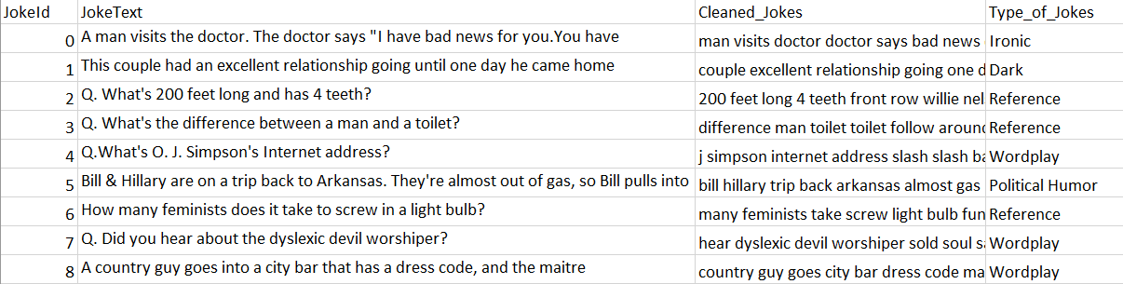
JokeText_Category.csv
Notes:
s the data already clean/structured for your ML problem? If not, how did you prepare the data?

Slide 13
Cleaned Dataset-Joker.csv
For Statistical Analysis & Clustering

Slide 14
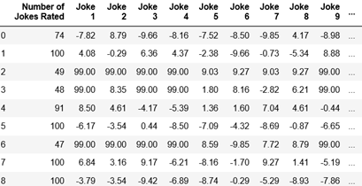
Preparing the Rating Data
Range of user rating: -10 to 10
Replace 99.00 with 0 (neutral)
Reduce size of data
from 24,983 to 10,000 user
Notes:
s the data already clean/structured for your ML problem? If not, how did you prepare the data?

Slide 15
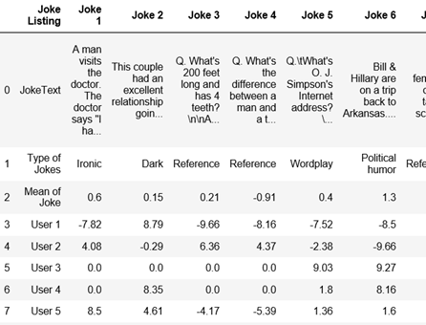
Cleaned Dataset-Joker.csv :
For Statistical Analysis & Clustering
Inserted other information
Mean of Joke
Joke text and category
User ID
Notes:
s the data already clean/structured for your ML problem? If not, how did you prepare the data?

Slide 16
Data Exploration (Visualisations)
2

Slide 17
Statistical Visualisations
2.1
Notes:
The first part will be statistical visualisations.

Slide 18
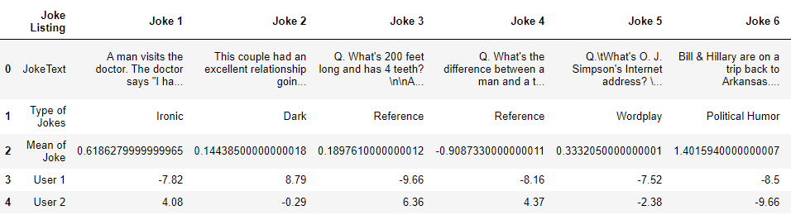
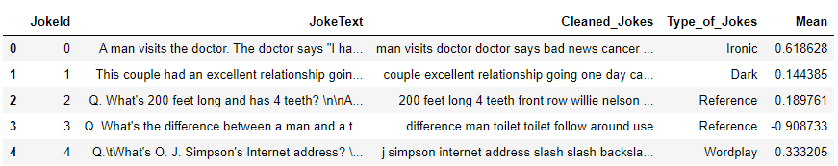
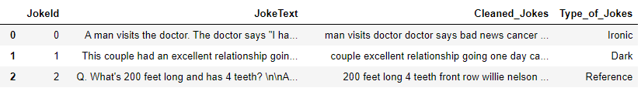
Dataframe: joke_catmean
Cleaned Dataset-Joker.csv
Concat together = Dataframe: joke_catmean
JokeText_Category.csv
Notes:
I will be using 2 csv files and join them together to get a dataframe called jokecat_mean as shown in the orange square.

Slide 19
Statistical Visualisation for Jokes Ratings:
Catplot - Type of Jokes
Boxplot - Average Ratings per Category
Jointplot + Heatmap - Length of Jokes over Ratings
Notes:
Using that dataframe, 3 visualisations can be plotted.

Slide 20
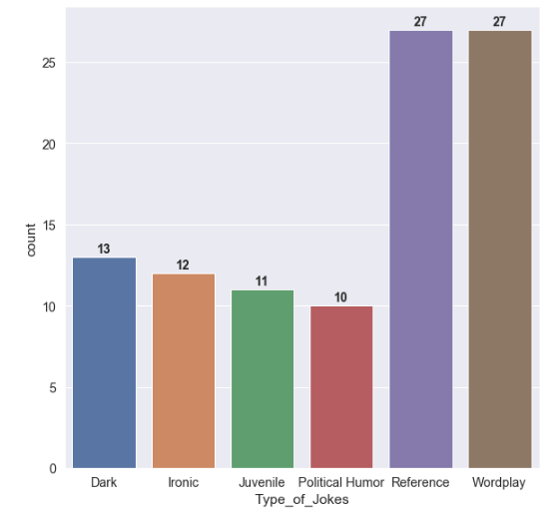
Catplot:
Notes:
The first will be a Catplot for the type of jokes. From the plot, we can see that references and wordplay type have the most number of jokes.

Slide 21
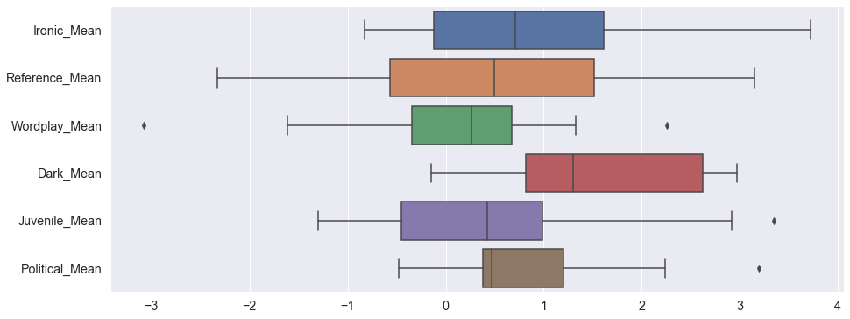
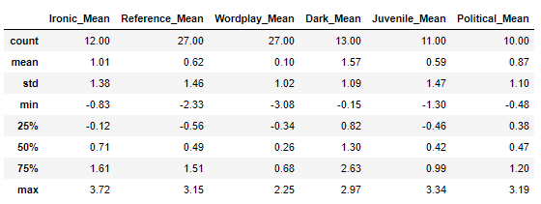
Boxplot:
Notes:
Next, Boxplot for the average ratings per category. The dark category has both the largest median and mean value.

Slide 22
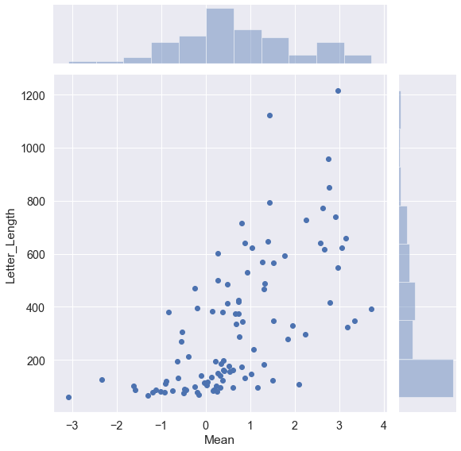
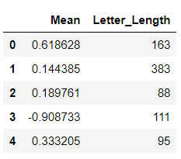
Jointplot:
Index = JokeID, 0 = First Joke
Length of the joke
Notes:
The last plot will be a joint plot to see the relation between the mean ratings and length of jokes. From the scatter plot we can see a positive linear relation.

Slide 23
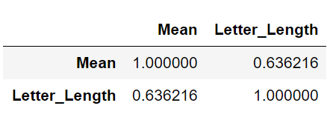
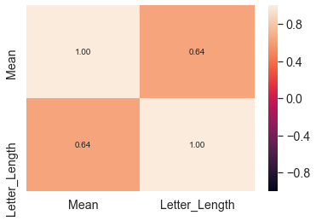
Correlation:
Positive relation between the Length of Jokes and Ratings
Notes:
A heatmap is plotted to find out the correlation value. With a value of 0.63, it justifies that jokes with longer length have higher ratings.

Slide 24
INSIGHT FROM JOINTPLOT
Conclusion:
Generally, longer jokes have higher ratings
With longer description of the jokes, the user may be able to understand more and this may be why the user rated jokes with longer length a higher ratings.
Notes:
This is the insight derived from the jointplot.

Slide 25
New Things Learnt
Network
Visualisation
2.2
Notes:
Next portion will be network visualisations.

Slide 26
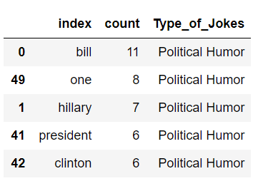
Unigram: Used the JokeText_Category.csv
Political Humor Unigram Df:
Data Cleaning by Category
6 Dataframes created for each type of jokes
Word count for each repeated words in that category
Notes:
6 dataframes are created for each joke type and we will count the number of repeated words. The picture above is an example of one Dataframe that we use.

Slide 27
Network Visualization for Different Type of Jokes
New Things Learnt
NetworkX Graph - Unigram
NetworkX Graph - Bigram
Notes:
2 network graphs can be plotted using those dataframes.

Slide 28
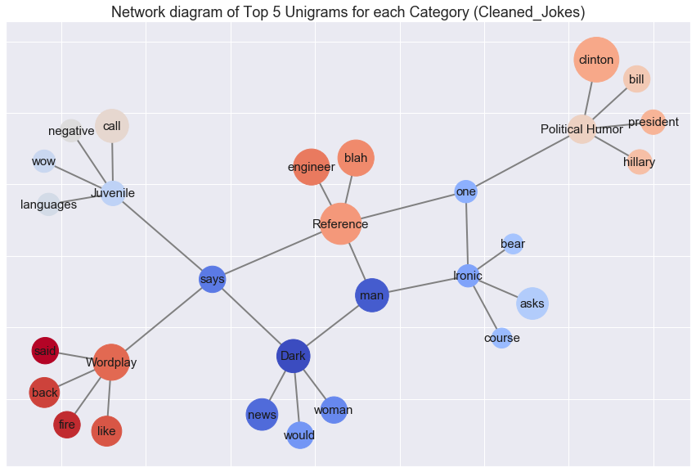
Unigram:
INSIGHT:
Political Humor: have words mostly related to president.
Dark: have words like news (bad / good news)
Legend:
Links - The word is present in the category
Size of Circle - Word Count
Notes:
From the Unigram network graph, we can see that political humor have words related to president and Dark type have words like news.

Slide 29
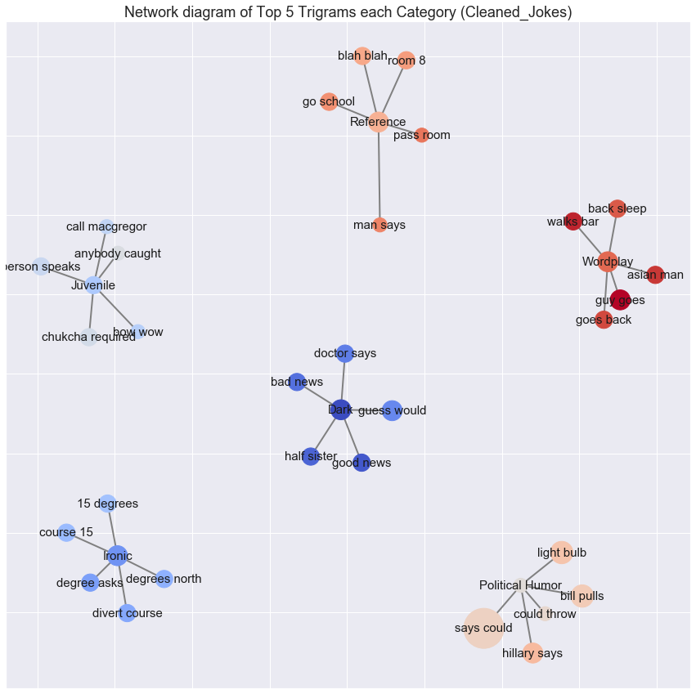
Bigram:
Network diagram of Top 5 Bigrams for each Category (Cleaned_Jokes)
Notes:
The second Network graph will be for bigram. Looking at dark type, you can see words like doctor and bad news, good news.

Slide 30
New Things Learnt
Text
Visualisations
2.3
Notes:
The last portion will be Text Visualisations.

Slide 31
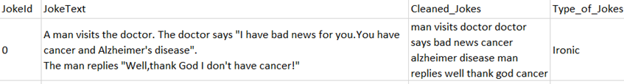
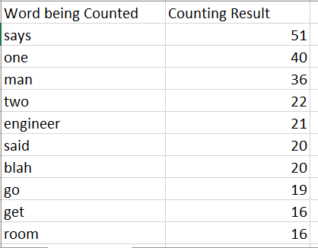
JokeText_Category.csv -> Word_Counter.csv
Using word tokenization & Counter
Export File into Word_Counter.csv
Notes:
We will tokenize the cleaned joke text and find the word count for each token.

Slide 32
Visualisation for JokeText
New Things Learnt
Countplot - Most Common Words
Word Cloud - Most Common Words
Notes:
Using the word counter, a countplot and word cloud can be plotted.

Slide 33
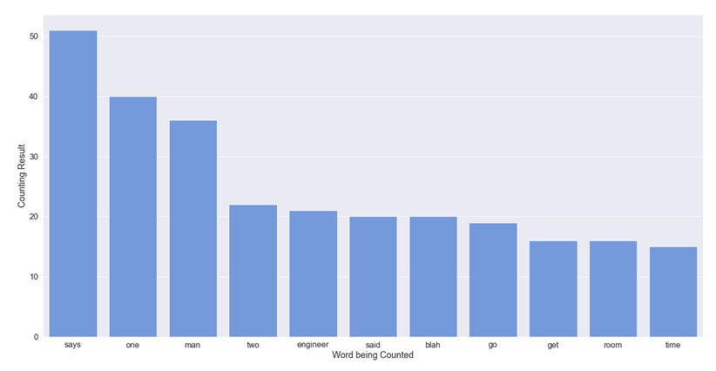
Countplot:
Notes:
This is the countplot. The most frequently used word is ‘says'.

Slide 34
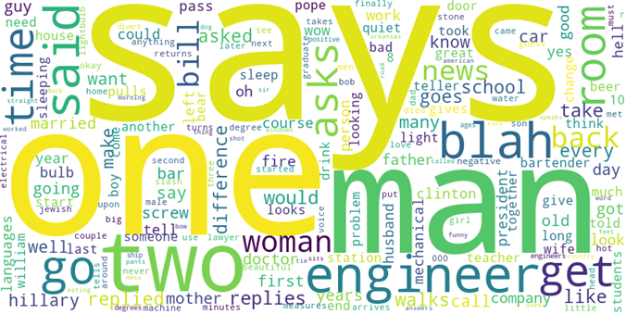
Word Cloud
Notes:
A similar word cloud is as shown above. With the largest word been the most count. I will now pass my time back to Sean to talk about our Clustering Model.

Slide 35
Clustering Model
3
Notes:
I will now pass my time back to Sean to talk about our Clustering Model.

Slide 36
Clustering Model
Why Clustering?
To cluster users with the same rating pattern for comparison.
Target: Identify if there is contrasting view in when rating the joke.

Slide 37
Suitable Cluster Model:
K-Means using K-Means ++
Able to handle very large sample
10,000 user with 100 jokes per user
Distance between points

Slide 38
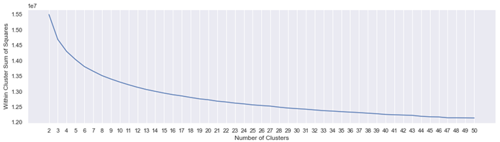
Suitable Cluster Model:
Parameter:
init ='k-means++‘
n_init = 20,random_state=0
Minimum cluster= 2, Maximum cluster=50

Slide 39
Determine Best Number of Cluster
▰(mean) Silhouette Coefficient
▻((X-Y)) / max(X,Y) , result range from -1 to 1
▻X: mean distance to the instances of the next closest cluster
▻Y: mean distance to the other points in the same cluster.

Slide 40
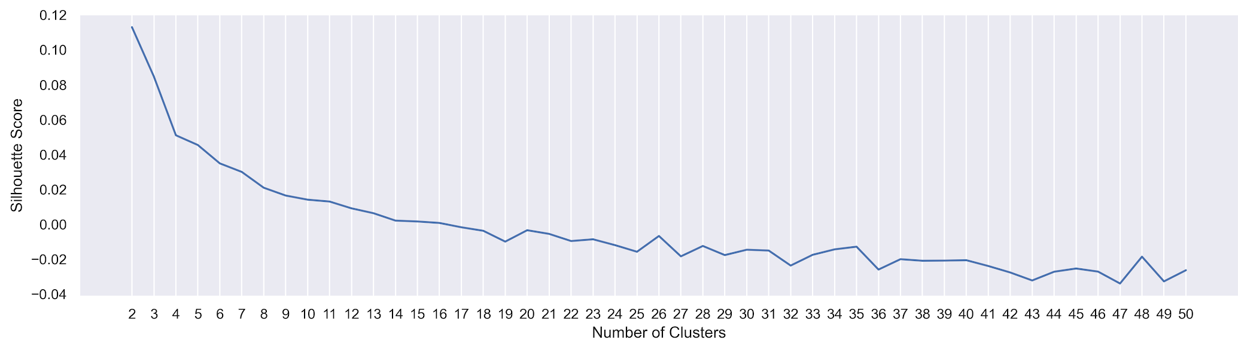
Silhouette Coefficient based on K-Means ++
▰Result close to -1: Point in wrong cluster
▰Result close to 1:
▻Cluster is very compact and far away from the other clusters

Slide 41
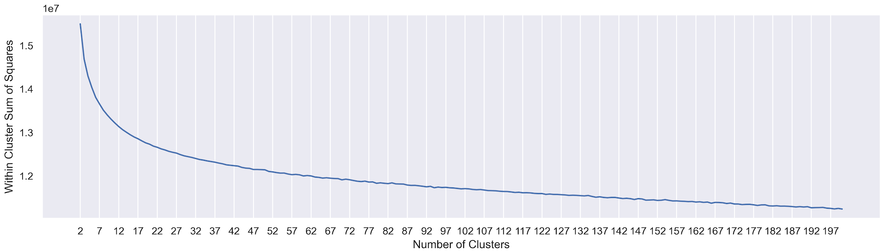
Silhouette Coefficient based on K-Means ++
▰Parameter
▻Minimum cluster= 2, Maximum cluster=200

Slide 42
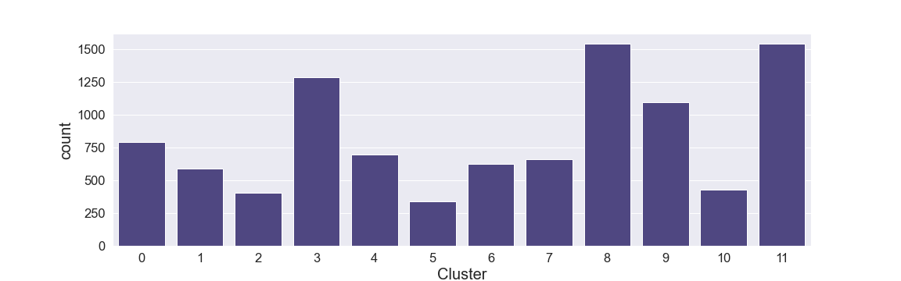
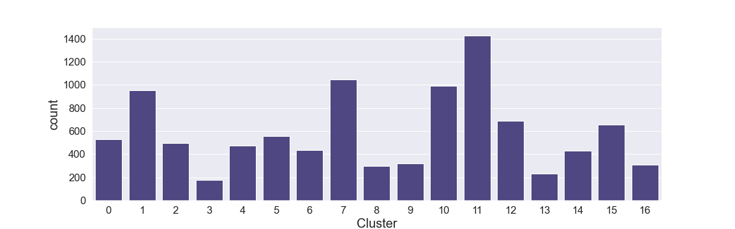
Cluster Count
12 Cluster
vs
17 Cluster
Final Choice: 17 Cluster

Slide 43
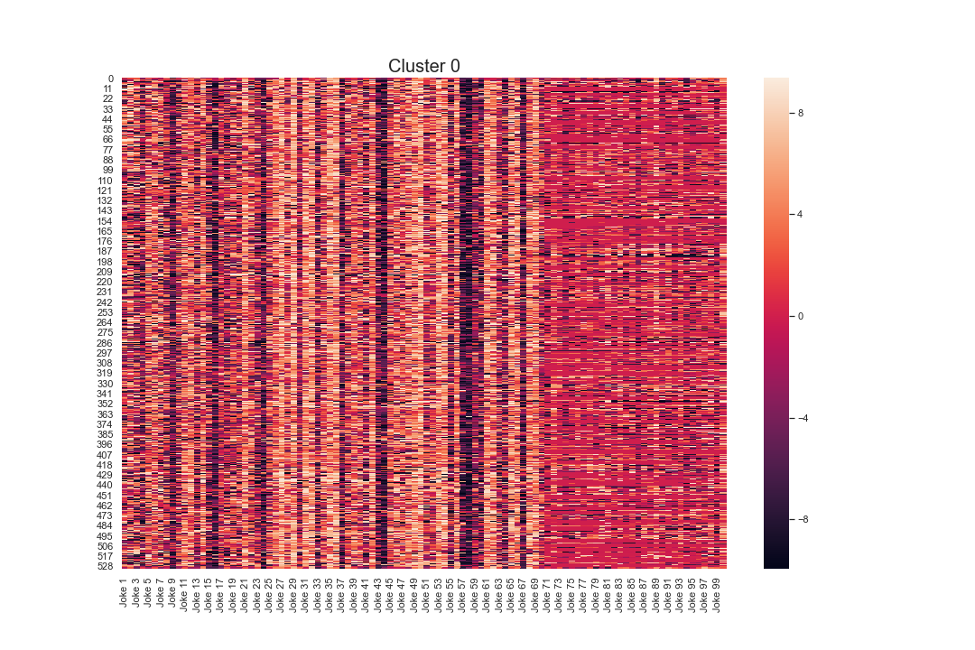
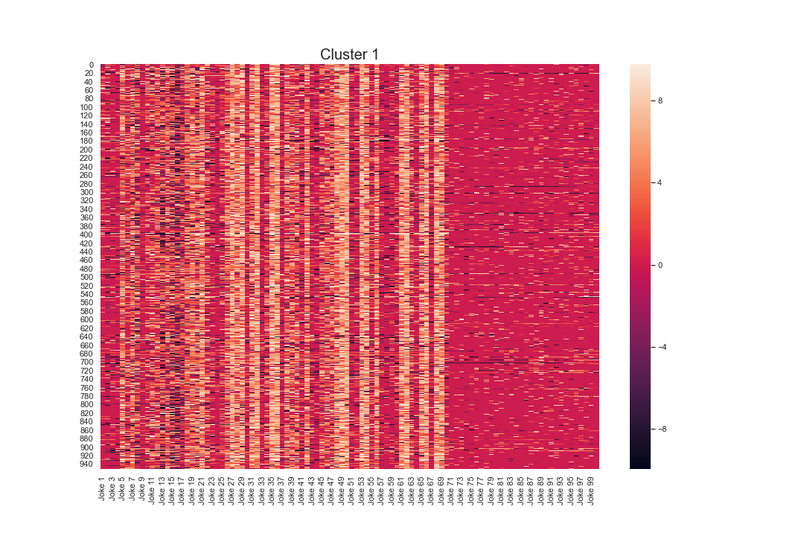
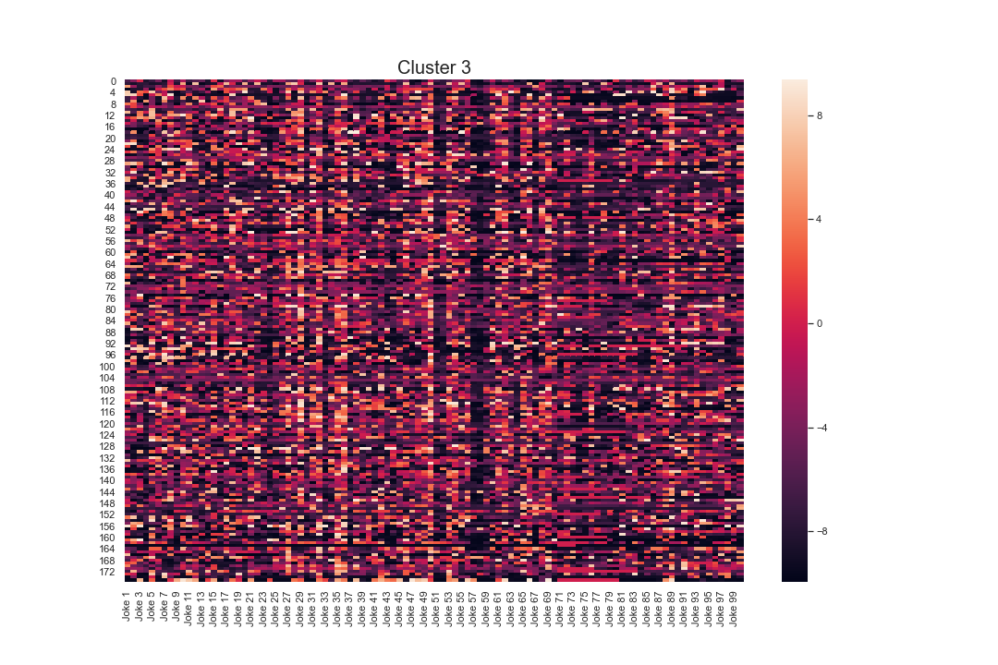
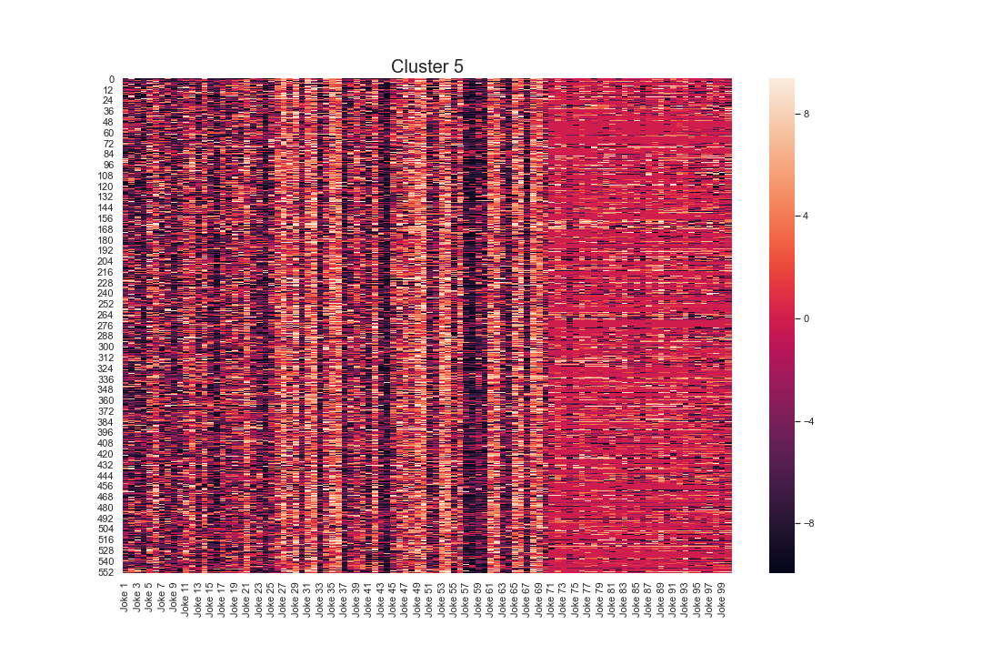
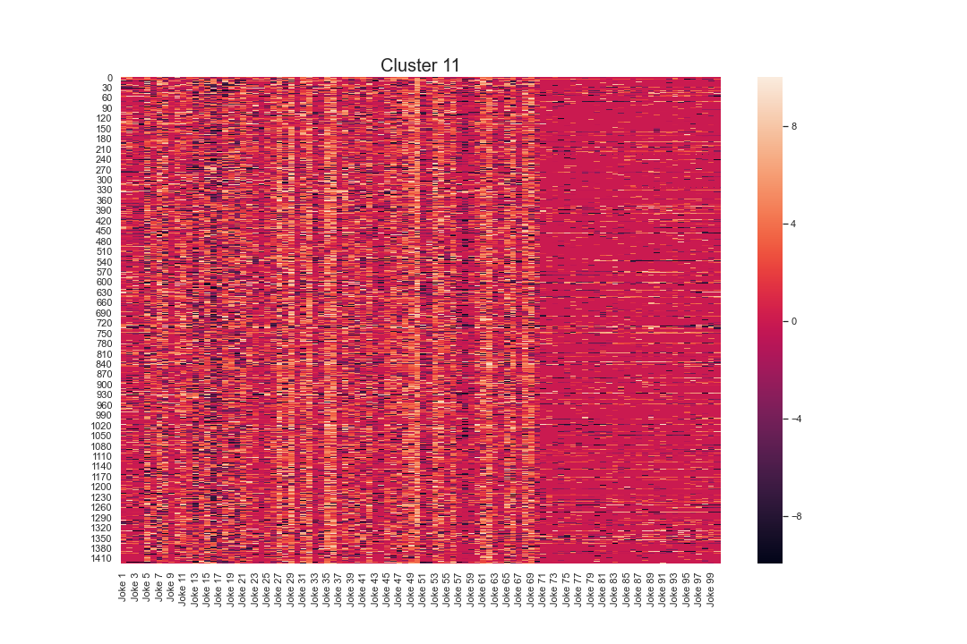
Heatmap Verification
Consistency in pattern: Yes with few strays
Notes:
Not going in depth: Just explain that 17 cluster is justifiable
Cluster 3 got the smallest number of user in it (maybe it is a group of user that does not fit to any pattern)

Slide 44
Clusters Analysis
4

Slide 45
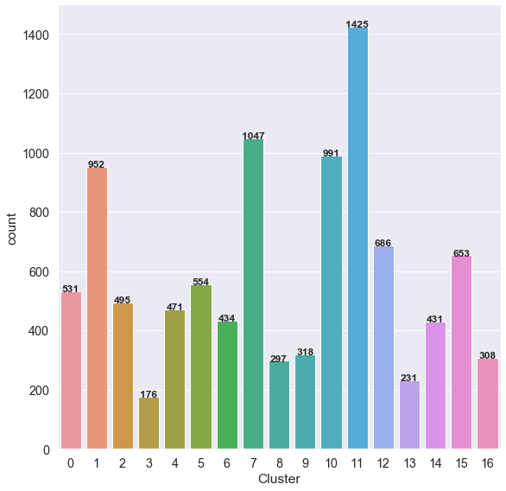
Clusters Analysis
Cluster 1 & Cluster 10
This bar chart shows the count of users in each Cluster.
We will be analysing Cluster 1 & 10
Why?
Both Clusters had similar numbers of users in each cluster.
Cluster 1 had 952 users
Cluster 10 had 991 users
Notes:
Thanks, Yong Zhi. For the cluster analysis, we will be looking at cluster 1 and cluster 10
We choose this two clusters as the number of users in both clusters are similar in size

Slide 46
How?
Quick Analysis Heat Map
Find out the type of jokes the user like in the cluster
Show Positive and Negative count of the ratings that the user rated
Analysis which individual joke that the users generally like or dislike
Notes:
How do we analysis the cluster?
First, we do quick analysis of the heatmap, then we find out the type of jokes the user like in the cluster by counting the number of positive and negative ratings
Last, we will see which individual joke the users generally like or dislike by looking at the mean rating of the joke

Slide 47
Cluster 1
4.1

Slide 48
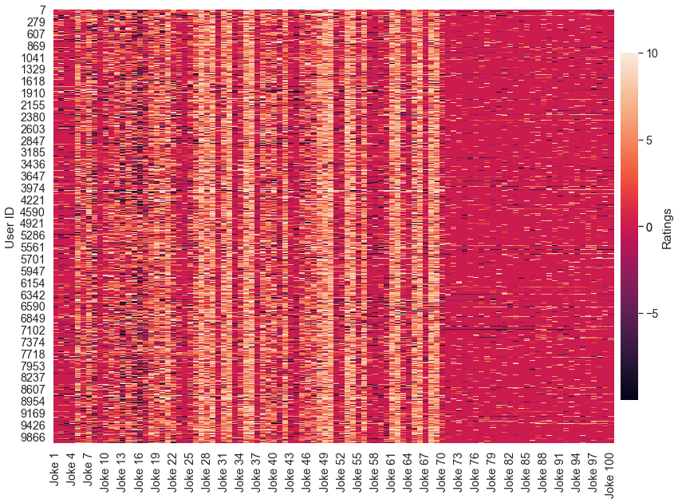
Heatmap for Cluster 1
Quick Analysis:
Neutral:
Jokes 70-100 (red in colour)
Positive:
Joke, 4, 28, 49 … (stripes of orange)
Negative:
Jokes 13-17 (dark purple in colour)
Notes:
First we look at cluster 1, a quick look at the heatmap, we can see some patterns, there are strips of orange vertically which indicates that the users give the joke positive ratings, there are some dark reds which indicate that the users give negative ratings. The chunk of red at the back indicates that the users did not rate or give neutral to the joke.

Slide 49
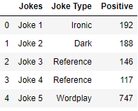
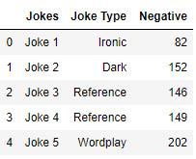
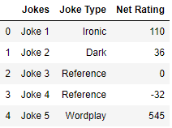
Cluster 1: Catplot
POSITIVE TABLE NEGATIVE TABLE NET RATING TABLE
Notes:
Next we move on the bar chart, this are the tables which shows the positive and negative ratings. I added the net rating which is the difference in the positive and negative rating of the joke. We’ll convert this tables into bar chart

Slide 50
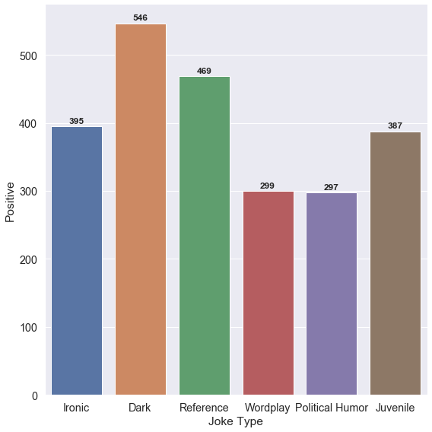
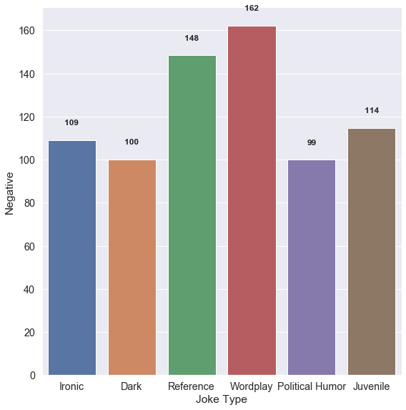
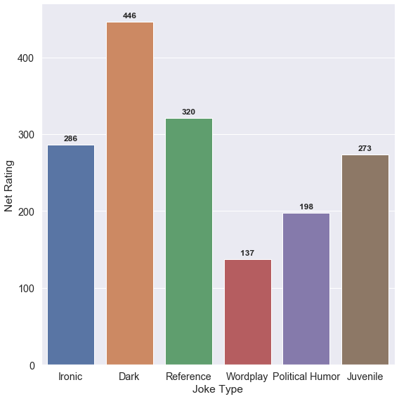
Catplot for Cluster 1
Likes : Dark and Reference Joke
Dislike: Wordplay Jokes
Notes:
I will be examining the net rating bar chart on the right. As you can see all that majority of the users in this cluster gave positive ratings to all jokes.

Slide 51
INSIGHT FROM CATPLOT
Conclusion:
Generally all users give positive ratings to all joke
57% of users in this cluster give dark category jokes a positive rating
49% of users in this cluster give Reference category jokes a Positive rating
24% of users in this cluster give Reference category jokes a Positive rating
Majority of the users like Dark and Reference joke
Wordplay Jokes are not as well liked as compared to the rest of the category
Notes:
And from this chart we can say that the users generally like dark and reference joke the most and wordplay jokes the least.

Slide 52
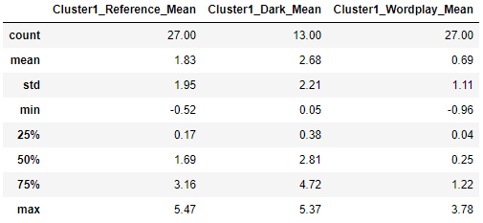
Cluster 1: Category Analysis Based on Category Chosen
Notes:
Next will be moving on to the boxplot. This is the table we’ll be using, the average rating of the jokes

Slide 53
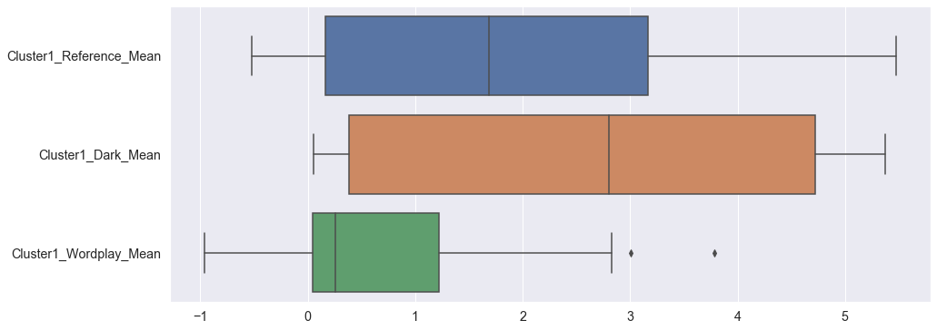
Boxplot for Cluster 1
INSIGHT:
Reference:
Maximum Rating of 5.47 is derived from Joke 32
Minimum Rating of -0.52 is derived from Joke 58
Dark:
Maximum Rating of 5.37 is derived from Joke 35
Minimum Rating of 0.05 is derived from Joke 2
Wordplay:
Maximum Rating of 3.78 is derived from Joke 65
Minimum Rating of 0.96 is derived from Joke 16
2 outliers
Notes:
From the boxplot, we can see the spread of rating that the user give, we can also see the max and min rating of each joke and from there, with that, we can derive which joke had the lowest or highest rating

Slide 54
Cluster 10
4.2
Notes:
Next I will roughly go through cluster 10

Slide 55
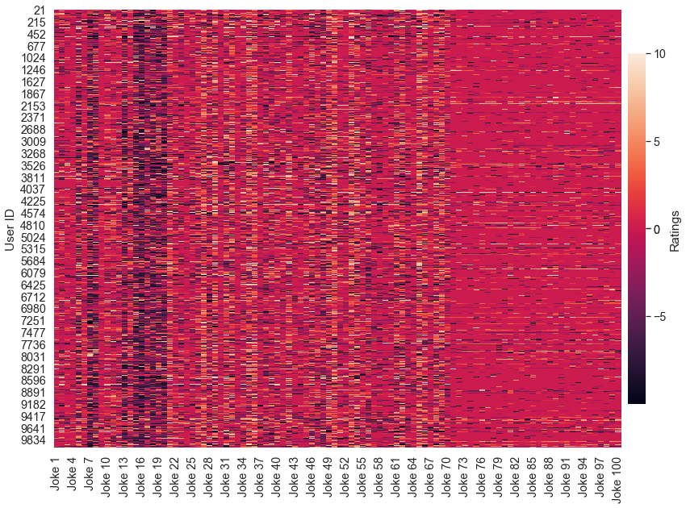
Heatmap for Cluster 10
Quick Analysis:
Neutral:
Jokes 70-100 (red in colour)
Positive:
Very Little Orange
Negative:
Jokes 13-19 (dark purple in colour)
Notes:
From the heatmap, u can see a significant difference from cluster 1, it is mostly red in colour which indicate that the users give low or negative ratings to every joke

Slide 56
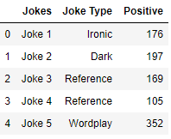
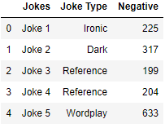
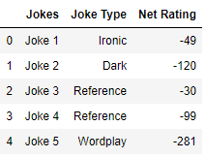
Cluster 10: Catplot
POSITIVE TABLE NEGATIVE TABLE NET RATING TABLE
Notes:
<skip>

Slide 57
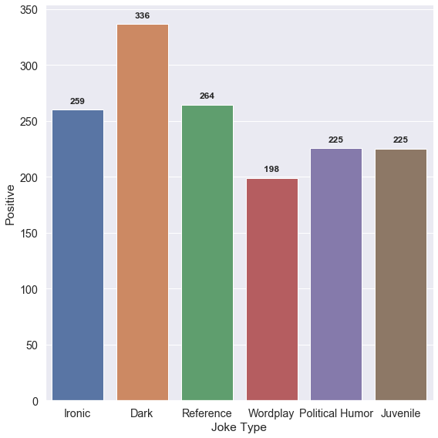
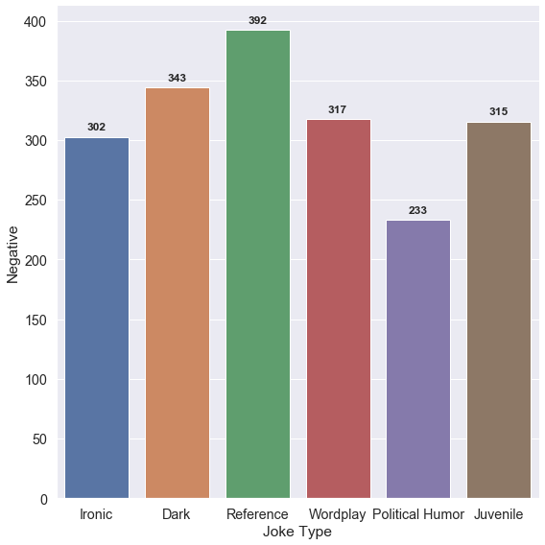
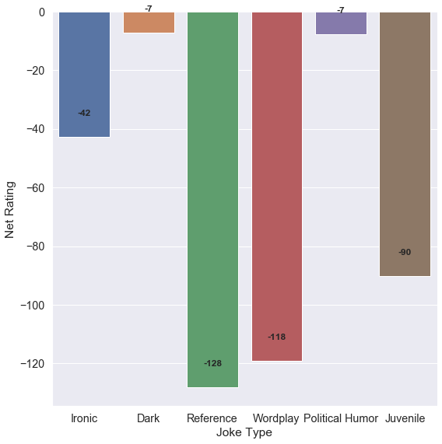
Catplot for Cluster 10
Dislikes : Reference & Wordplay
Least Dislike: Dark & Political Humor
Notes:
From the bar chart, we can see that all jokes are have more negative ratings. However for dark and political, they have about 50/50 in terms of positive and negative rating

Slide 58
INSIGHT FROM CATPLOT
Conclusion:
Based on the catplot, the number of users in this cluster that rate positively and negatively dark and political humor category jokes are about 50/50
39% of users in this cluster give Reference category jokes a negative rating
32% of users in this cluster give Wordplay category jokes a negative rating
32% users in this cluster give Juvenile category jokes a negative rating
Majority of the users dislike Reference and Wordplay joke
Dark and Political Jokes are the least disliked
Notes:
From this, we can say that the majority of the users dislike reference and wordplay jokes while dark and political jokes are the least dislike.

Slide 59
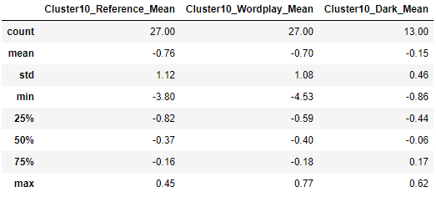
Cluster 10: Category Analysis Based on Category Chosen
Notes:
<skip>

Slide 60

Boxplot for Cluster 10
INSIGHT:
Reference:
Maximum Rating of 0.45 is derived from Joke 21
Minimum Rating of -3.80 is derived from Joke 20
4 outliers
Wordplay:
Maximum Rating of 0.77 is derived from Joke 65
Minimum Rating of -4.53 is derived from Joke 16
4 outliers
Dark:
Maximum Rating of 0.62 is derived from Joke 53
Minimum Rating of -0.86 is derived from Joke 38
Notes:
We’ll move on to the box plot, the spread of ratings is lower than cluster 1 and there are more outliers

Slide 61
BACK TO OBJECTIVE
Objective: Explore how users rate the jokes
To identify whether there’s diverse group with contrasting likes and dislikes of various jokes.
Contrast between the two clusters
Cluster 1 | Cluster 10
Generally give positive ratings to the jokes Likes dark and reference jokes Particularly rate joke 32 and 35 the highest Majority of the users in the cluster rate reference joke from 0 to +3 | Generally give negative ratings to the jokes Dislike reference and wordplay jokes Particularly rate joke 20 and 26 the lowest Majority of the users in the cluster rate reference joke from -1 to 0
Notes:
So back to the objective which is the identify if there is a diverse group. The answer is yes there is as there is a contrast between the two clusters. For more indept analysis, you can take a look at the juypter notebook and the codes.

Slide 62
Contribution
5

Slide 63
Contribution Table
NAME | CONTRIBUTION
TEAM EFFORT | Problem Statement & PPT
TAN MEI XUAN (U1921903J) | Statistical and Network Visualisation Data Preparation for Visualisations Dataframes Clustering Category Dataframes
SEAH YONG ZHI (U1922524L) | Text Visualisation Data Preparation for Cleaned Jokes and Main Dataset Clustering Model
GOH CHENG GUAN, CLIVE (U1920078G) | Clusters Analysis Catplot for Negative/Positive/Net-Ratings [Within Cluster Analysis]
Notes:
This is our contributions, thank you and we’re open up for questions

Slide 64
THANKS!
Any questions?

Slide 65
Other Clustering Methods Tried

Slide 66
Suitable Cluster Model:
DBSCAN:
Able to handle very large sample
10,000 user with 100 jokes per user
Distance between nearest points
Parameter:
eps: maximum distance between two points for one to be considered as in the neighborhood of the other.
min_samples: number of points needed to be considered a cluster

Slide 67

Nearest Neighbor to determine EPS
Parameter:
N_neighbors: number of nearest neighbors to include in the majority of the voting process
Estimated best EPS: 56

Slide 68





DBSCAN Result
Notes:
Min sample: number of dimension +1 for our case is 101
Cluster -1 refers to point deem as noisy and hence thrown into this cluster by the scan.
OPTICS method of cluster also produce the same result.

